Slide 1
Chapter II
Structuring and Modularizing the Network
09 Hours

Slide 2
This chapter introduces a modular hierarchical approach to network design, the Cisco Enterprise Architecture.
The chapter begins with a discussion of the hierarchical network structure.
The next section introduces network modularization and discusses the details of the Cisco Enterprise Architecture

Slide 3
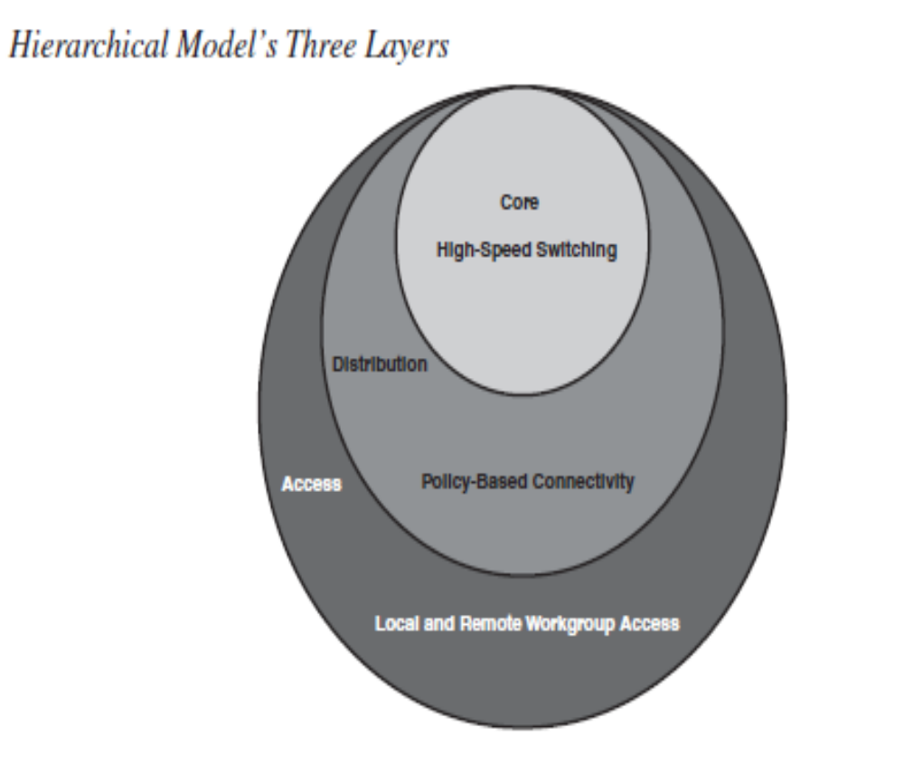
Hierarchical Network Model
The hierarchical network model provides a framework that network designers can use to help ensure that the network is flexible and easy to implement and troubleshoot.
Hierarchical Network Design Layers

Slide 4
As shown in Figure the hierarchical network design model consists of three layers:
■ The access layer provides local and remote workgroup or user access to the network.
■ The distribution layer provides policy-based connectivity.
■ The core (or backbone) layer provides high-speed transport to satisfy the connectivity and transport needs of the distribution layer devices.
Each hierarchical layer focuses on specific functions, thereby allowing the network designer to choose the right systems and features based on their function within the model.
This approach helps provide more accurate capacity planning and minimize total costs.

Slide 5
Access Layer Functionality
The Role of the Access Layer
The access layer is the concentration point at which clients access the network.
Access layer devices control traffic by localizing service requests to the access media.
The purpose of the access layer is to grant user access to network resources. Following are the access layer’s characteristics:
■ In the campus environment, the access layer typically incorporates switched LAN devices with ports that provide connectivity for workstations and servers.
■ In the WAN environment, the access layer for teleworkers or remote sites provides access to the corporate network across some wide-area technology, such as Frame Relay, Multiprotocol Label Switching (MPLS), Integrated Services Digital Network, leased lines, Digital Subscriber Line (DSL) over traditional telephone copper lines, or coaxial cable.

Slide 6
■ So as not to compromise network integrity, access is granted only to authenticated users or devices (such as those with physical address or logical name authentication). For example, the devices at the access layer must detect whether a telecommuter who is dialing in is legitimate, yet they must require minimal authentication steps for the telecommuter.

Slide 7
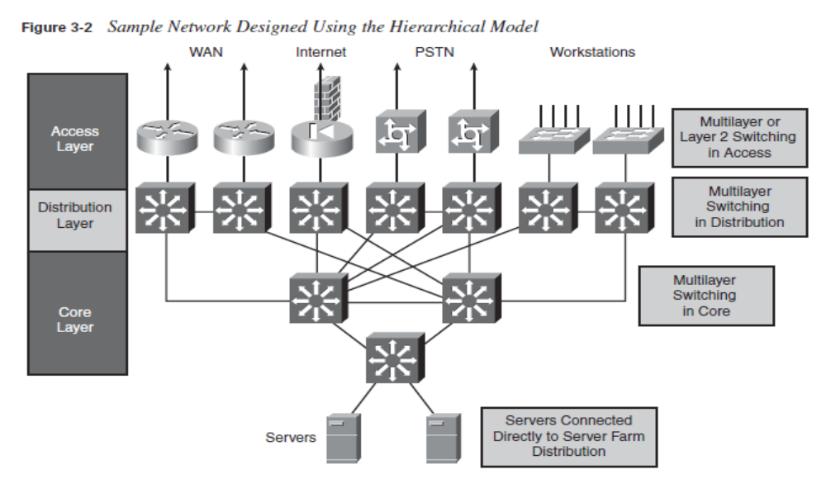

Slide 8
Enterprise Network Campus Design:-
An understanding of network scale and knowledge of good structured engineering principles is recommended when discussing network campus design.
Network Requirements:-
When discussing network design, it is useful to categorize networks based on the number of devices serviced:
Small network: Provides services for up to 200 devices.
Medium-size network: Provides services for 200 to 1,000 devices.
Large network: Provides services for 1,000+ devices.
Network designs vary depending on the size and requirements of the organizations. For example, the networking infrastructure needs of a small organization with fewer devices will be less complex than the infrastructure of a large organization with a significant number of devices and connections.

Slide 9
The Cisco Certified Design Associate (CCDA®) is an industry-recognized certification for network design engineers, technicians, and support engineers who demonstrate the skills required to design basic campus, data center, security, voice, and wireless networks.

Slide 10
Structured Engineering Principles
Regardless of network size or requirements, a critical factor for the successful implementation of any network design is to follow good structured engineering principles. These principles include:-
1.Hierarchy: A hierarchical network model is a useful high-level tool for designing a reliable network infrastructure. It breaks the complex problem of network design into smaller and more manageable areas.
2. Modularity: By separating the various functions that exist on a network into modules, the network is easier to design. Cisco has identified several modules, including the enterprise campus, services block, data center, and Internet edge.
3.Resiliency: The network must remain available for use under both normal and abnormal conditions. Normal conditions include normal or expected traffic flows and traffic patterns, as well as scheduled events such as maintenance windows. Abnormal conditions include hardware or software failures, extreme traffic loads, unusual traffic patterns, denial-of-service (DoS) events, whether intentional or unintentional, and other unplanned events.

Slide 11
4. Flexibility: The ability to modify portions of the network, add new services, or increase capacity without going through a major forklift upgrade (i.e., replacing major hardware devices).
To meet these fundamental design goals, a network must be built on a hierarchical network architecture that allows for both flexibility and growth.

Slide 12
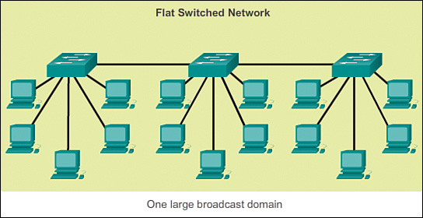
Hierarchical Network Design
This topic discusses the three functional layers of the hierarchical network model: the access, distribution, and core layers.
Network Hierarchy
Early networks were deployed in a flat topology as shown in figure

Slide 13
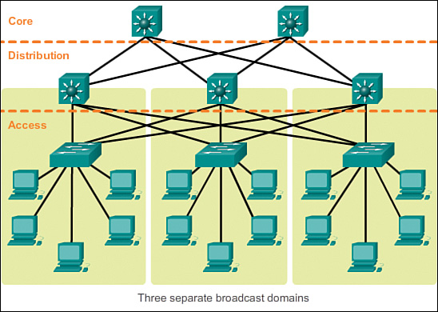
Hubs and switches were added as more devices needed to be connected.
A flat network design provided little opportunity to control broadcasts or to filter undesirable traffic.
As more devices and applications were added to a flat network, response times degraded, making the network unusable.
A better network design approach was needed. For this reason, organizations now use a hierarchical network design as shown in figure

Slide 14
A hierarchical network design involves dividing the network into discrete layers.
Each layer, or tier, in the hierarchy provides specific functions that define its role within the overall network.
This helps the network designer and architect to optimize and select the right network hardware, software, and features to perform specific roles for that network layer.
Hierarchical models apply to both LAN and WAN design.
The benefit of dividing a flat network into smaller, more manageable blocks is that local traffic remains local. Only traffic that is destined for other networks is moved to a higher layer.

Slide 15
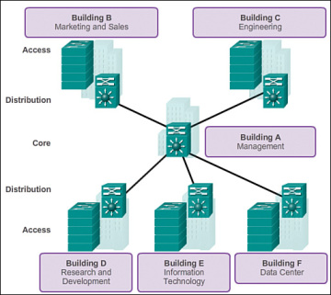
A typical enterprise hierarchical LAN campus network design includes the following three layers:
Access layer: Provides workgroup/user access to the network
Distribution layer: Provides policy-based connectivity and controls the boundary between the access and core layers
Core layer: Provides fast transport between distribution switches within the enterprise campus

Slide 16
The Access Layer:-
In a LAN environment, the access layer highlighted grants end devices access to the network.
In the WAN environment, it may provide teleworkers or remote sites access to the corporate network across WAN connections.
As shown in Figure, the access layer for a small business network generally incorporates Layer 2 switches and access points providing connectivity between workstations and servers.
The access layer serves a number of functions, including
Layer 2 switching
High availability
Port security
QoS classification and marking and trust boundaries
Address Resolution Protocol (ARP) inspection
Virtual access control lists (VACLs)
Spanning tree

Slide 17
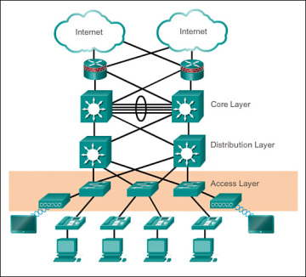

Slide 18
The Distribution Layer
The distribution layer aggregates the data received from the access layer switches before it is transmitted to the core layer for routing to its final destination.
Distribution layer is the boundary between the Layer 2 domains and the Layer 3 routed network.
The distribution layer device is the focal point in the wiring closets. Either a router or a multilayer switch is used to segment workgroups and isolate network problems in a campus environment.
A distribution layer switch may provide upstream services for many access layer switches.
The distribution layer can provide
Aggregation of LAN or WAN links.
Policy-based security in the form of access control lists (ACLs) and filtering.
Routing services between LANs and VLANs and between routing domains (e.g., EIGRP to OSPF).
Redundancy and load balancing.

Slide 19
The Core Layer
The core layer is also referred to as the network backbone.
The core layer consists of high-speed network devices such as the Cisco Catalyst 6500 or 6800.
These are designed to switch packets as fast as possible and interconnect multiple campus components, such as distribution modules, service modules, the data center, and the WAN edge.
The core layer is critical for interconnectivity between distribution layer devices (for example, interconnecting the distribution block to the WAN and Internet edge).
The core should be highly available and redundant.
The core aggregates the traffic from all the distribution layer devices, so it must be capable of forwarding large amounts of data quickly.
Considerations at the core layer include
Providing high-speed switching (i.e., fast transport)
Providing reliability and fault tolerance
Scaling by using faster, and not more, equipment
Avoiding CPU-intensive packet manipulation caused by security, inspection, quality of service (QoS) classification, or other processes

Slide 20
Modular Approach To Network Design:-
The Cisco Enterprise Architecture is a modular approach to network design. This section identifies enterprise architecture modules that are commonly found in medium-to-large organizations.
Modular Design:-
While the hierarchical network design works well within the campus infrastructure, networks have expanded beyond these borders.
Networks have become more sophisticated and complex.
The central campus site now requires connections to branch sites and support for teleworking employees working from home offices or other remote locations.
Large organizations may also require dedicated connections to offsite data centers.
As the complexity of the network increased to meet these demands, it became necessary to adjust the network design to one that uses a more modular approach.

Slide 21
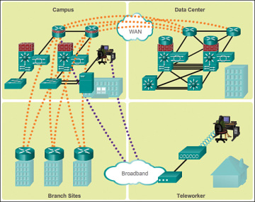

Slide 22
A modular network design separates the network into various functional network modules, each targeting a specific place or purpose in the network.
The modules represent areas that have different physical or logical connectivity.
They designate where different functions occur in the network. Using a modular approach has several benefits, including
Failures that occur within a module can be isolated from the remainder of the network, providing for simpler problem detection and higher overall system availability.
Network changes, upgrades, or the introduction of new services can be made in a controlled and staged fashion, allowing greater flexibility in the maintenance and operation of the campus network.
When a specific module no longer has sufficient capacity or is missing a new function or service, it can be updated or replaced by another module that has the same structural role in the overall hierarchical design.
Security can be implemented on a modular basis allowing for more granular security control.

Slide 23
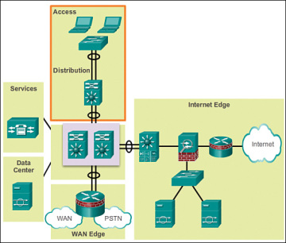
Modules in the Enterprise Architecture :-
A modular approach to network design further divides the three-layer hierarchical design by pulling out specific blocks or modular areas. These basic modules are connected together via the core of the network.
Basic network modules include
Access-distribution: Also called the distribution block, this is the most familiar element and fundamental component of a campus design.

Slide 24
Services: This is a generic block used to identify services such as centralized Lightweight Access Point Protocol (LWAPP) wireless controllers, unified communications services, policy gateways, and more.
Data center: Originally called the server farm. This block is responsible for managing and maintaining many data systems that are vital to modern business operations. Employees, partners, and customers rely on data and resources in the data center to effectively create, collaborate, and interact.
Enterprise edge: Consists of the Internet edge and the WAN edge. These blocks offer connectivity to voice, video, and data services outside the enterprise

Slide 25
Cisco Enterprise Architecture Model
The Cisco Enterprise Architecture is a modular approach to network design. This topic discusses the enterprise campus module, enterprise edge module, and the service provider edge module.
Cisco Enterprise Architecture Model
To accommodate the need for modularity in network design, Cisco developed the Cisco Enterprise Architecture model.
This model provides all the benefits of the hierarchical network design on the campus infrastructure, and facilitates the design of larger, more scalable networks.
The Cisco Enterprise Architecture model separates the enterprise network into functional areas that are referred to as modules.
The modularity that is built in to the architecture allows flexibility in network design and facilitates implementation and troubleshooting.

Slide 26
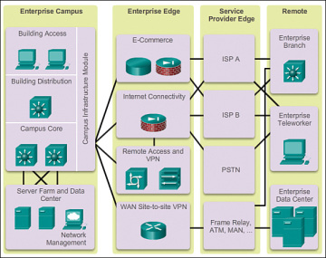

Slide 27
As shown in Figure, the following are the primary Cisco Enterprise Architecture modules:
Enterprise campus
Enterprise edge
Service provider edge
Connected to the service provider edge are the remote modules, including
Enterprise branch
Enterprise teleworker
Enterprise data center

Slide 28
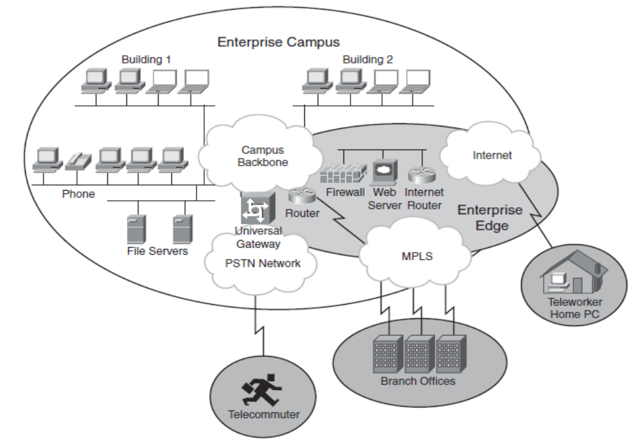

Slide 29
Cisco Enterprise Campus
A campus network is a building or group of buildings connected into one enterprise network that consists of many LANs.
A campus is generally limited to a fixed geographic area, but it can span several neighboring buildings (for example, an industrial complex or business park environment). Regional offices, HOs, and mobile workers may need to connect to the central campus for data and information.
The enterprise campus module describes the recommended methods to create a scalable network while addressing the needs of campus-style business operations.
The architecture is modular and can easily expand to include additional campus buildings or floors as the enterprise grows.

Slide 30
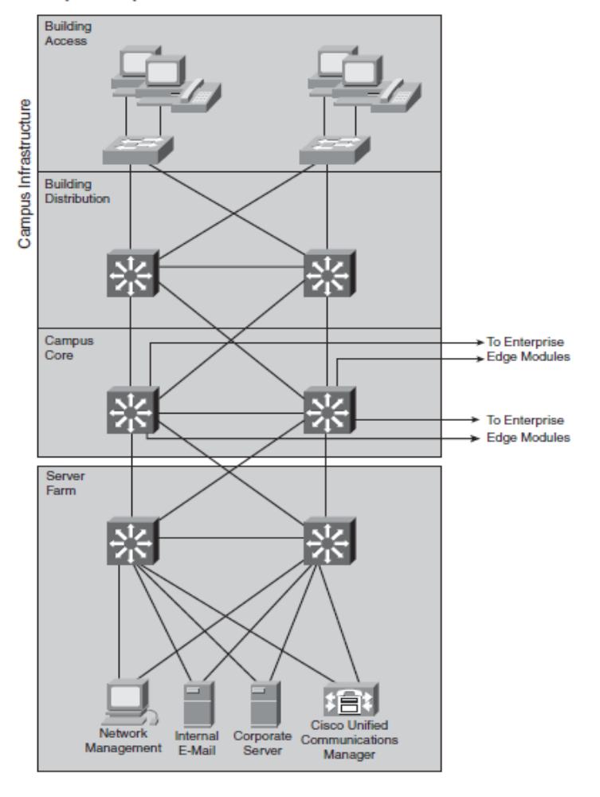
The enterprise campus module consists of the following submodules:
Building access
Building distribution
Campus core
Data center

Slide 31
The enterprise campus module architecture provides the enterprise with high availability through a resilient multilayer design, redundant hardware and software features, and automatic procedures for reconfiguring network paths when failures occur.
Integrated security protects against and mitigates the impact of worms, viruses, and other attacks on the network, even at the switch port level.
A high-capacity, centralized data center module can provide internal server resources to users.
The data center module typically also supports network management services for the enterprise, including monitoring, logging, troubleshooting, and other common management features from end to end.
The data center submodule typically contains internal email and corporate servers that provide application, file, print, email, and Domain Name System (DNS) services to internal users.

Slide 32
Follow these guidelines for creating the modules within an Enterprise Campus functional area:
Step 1 Select modules within the campus that act as buildings with access and distribution layers.
Step 2 Determine the locations and the number of access switches and their uplinks to distribution layer switches.
Step 3 Select the appropriate distribution layer switches, taking into account the number of access layer switches and end users. Use at least two distribution layer switches for redundancy.
Step 4 Consider two uplink connections from each access layer switch to the two distribution layer switches.
Step 5 Determine where servers are or will be located, and design the Server Farm module with at least two distribution layer switches that connect all servers for full redundancy. Include out-of-band network management connections to all critical devices in the campus network.

Slide 33
Step 6 Design the Campus Infrastructure module’s Campus Core layer using at least two switches and provide for the expected traffic volume between modules.
Step 7 Interconnect all modules of the Enterprise Campus with the Campus
Infrastructure module’s Campus Core layer in a redundant manner

Slide 34
Cisco Enterprise Edge:-
The enterprise edge module provides connectivity for voice, video, and data services outside the enterprise. This module often functions as a liaison between the enterprise campus module and the other modules.
As shown in Figure the enterprise edge module consists of submodules providing
E-commerce services
Internet connectivity
Remote access and VPN access
WAN site-to-site VPN access

Slide 35
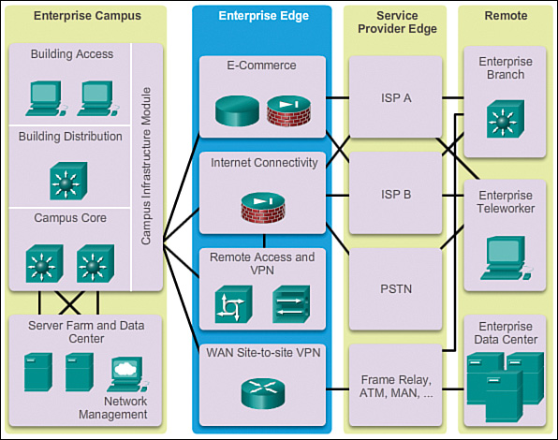

Slide 36
E-commerce networks and servers:
1. The e-commerce submodule enables enterprises to support e-commerce applications through the Internet.
2. It uses the high-availability designs of the data center module.
3. Devices located in the e-commerce submodule include web, application, and database servers; firewall and firewall routers; and network intrusion prevention systems (IPS).
Internet connectivity and demilitarized zone (DMZ):
1. The Internet submodule of the enterprise edge provides internal users with secure connectivity to Internet services such as public servers, email, and DNS.
2. Connectivity to one or several Internet service providers (ISPs) is also provided.
3.Components of this submodule include firewall and firewall routers, Internet edge routers, FTP and HTTP servers, SMTP relay servers, and DNS servers.

Slide 37
Remote access and VPN:
1. The VPN/remote access submodule of the enterprise edge provides remote-access termination services, including authentication for remote users and sites.
2. Components of this submodule include firewalls, dial-in access concentrators, Cisco Adaptive Security Appliances (ASA), and network intrusion prevention system (IPS) appliances.
WAN:
1. The WAN submodule uses various WAN technologies for routing traffic between remote sites and the central site.
2.Enterprise WAN links include technologies such as Multiprotocol Label Switching (MPLS), Metro Ethernet, leased lines, Synchronous Optical Network (SONET) and Synchronous Digital Hierarchy (SDH), PPP, Frame Relay, ATM, cable, digital subscriber line (DSL), and wireless.

Slide 38
Service Provider Edge
Enterprises use service providers (SPs) to link to other sites. As shown in Figure the SP edge module can include
Internet service providers (ISPs)
WAN services such as Frame Relay, ATM, and MAN
Public switched telephone network (PSTN) services
The SP edge provides connectivity between the enterprise campus module to the remote enterprise data center, enterprise branch, and enterprise teleworker modules.
The SP edge module Spans across large geographic areas in a cost effective manner
Converges voice, video, and data services over a single IP communications network
Supports QoS and service level agreements
Supports security using VPNs (IPsec / MPLS) over Layer 2 and Layer 3 WANs
When acquiring Internet services from an ISP, redundancy or failover should be considered. Redundant Internet connections vary depending if the enterprise is connecting to a single ISP or multiple ISPs.

Slide 39
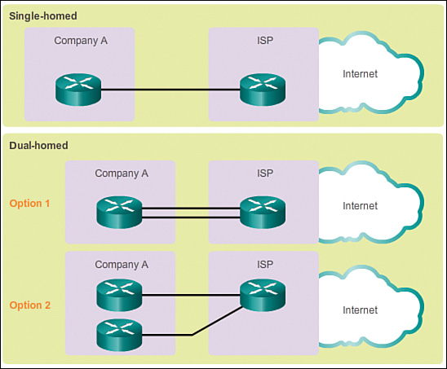
Single-homed: A single connection to an ISP
Dual-homed: Two or more connections to a single ISP

Slide 40
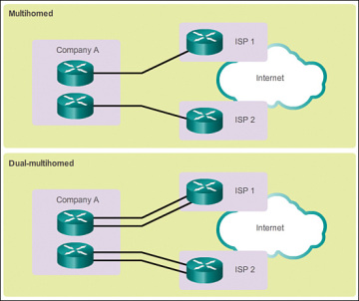
Alternatively, it is possible to set up redundancy using multiple ISPs, as shown in
Multihomed: Connections to two or more ISPs
Dual-multihomed: Multiple connections to two or more ISPs

Slide 41
Remote Functional Area
Enterprise Branch
The enterprise branch module includes remote branches that allow employees to work at noncampus locations.
These locations are typically responsible for providing security, telephony, and mobility options to employees, as well as general connectivity into the campus network and the different components located inside the enterprise campus.
The enterprise branch module allows enterprises to extend head-office applications and services, such as security, Cisco Unified Communications, and advanced application performance, to the remote branches.
The edge device connecting the remote site to the central site varies depending on the needs and size of the site.

Slide 42
Large remote sites may use high-end Cisco Catalyst switches, while smaller sites may use an ISR G2 router.
These remote sites rely on the SP edge to provide services and applications from the main site.

Slide 43
Enterprise Teleworker
The enterprise teleworker module is responsible for providing connectivity for workers who operate out of different geographically dispersed locations, including home offices, hotels, or customer/client sites.
The teleworker module recommends that mobile users connect to the Internet using the services of a local ISP, such as cable modem or DSL.
VPN services can then be used to secure communications between the mobile worker and central campus.
Integrated security- and identity-based networking services enable the enterprise to extend campus security policies to the teleworker.
Staff can securely log in to the network over the VPN and gain access to authorized applications and services from a single cost-effective platform.

Slide 44
Enterprise Teleworker
The enterprise teleworker module is responsible for providing connectivity for workers who operate out of different geographically dispersed locations, including home offices, hotels, or customer/client sites.
The teleworker module recommends that mobile users connect to the Internet using the services of a local ISP, such as cable modem or DSL.
VPN services can then be used to secure communications between the mobile worker and central campus.
Integrated security- and identity-based networking services enable the enterprise to extend campus security policies to the teleworker.
Staff can securely log in to the network over the VPN and gain access to authorized applications and services from a single cost-effective platform.

Slide 45
Enterprise Data Center
The enterprise data center module is a data center with all of the same functional options as a campus data center, but exists at a remote location.
This provides an added layer of security as the offsite data center can provide disaster recovery and business continuance services for the enterprise.
High-end switches such as the Cisco Nexus series switch use fast WAN services such as Metro Ethernet (MetroE) to connect the enterprise campus to the remote enterprise data center.
Redundant data centers provide backup using synchronous and asynchronous data and application replication.
Additionally, the network and devices offer server and application load balancing to maximize performance.
This solution allows the enterprise to scale without major changes to the infrastructure.

Slide 46
Services Within Modular Network
Businesses that operate large enterprise networks strive to create an enterprise-wide networked infrastructure and interactive services to serve as a solid foundation for business and collaborative applications.
This section explores some of the interactive services with respect to the modules that form the Cisco Enterprise Architecture.
Interactive Serives
Since the inception of packet-based communications, networks have always offered a forwarding service. Forwarding is the fundamental activity within an internetwork.
In IP, this forwarding service was built on the assumption that end nodes in the network were intelligent, and that the network core did not have intelligence.
With advances in networking software and hardware, the network can offer an increasingly rich, intelligent set of mechanisms for forwarding information.
Interactive services add intelligence to the network infrastructure, beyond simply moving a datagram between two points.

Slide 47
Interactive Serives
Security services: Ensure that all aspects of the network are secure, from devices connecting to the network to secured transport to data theft prevention
Mobility services: Allow users to access network resources regardless of their physical location
Storage services: Provide distributed and virtual storage across the infrastructure
Voice and collaboration services: Deliver the foundation by which voice can be carried across the network, such as security and high availability
Compute services: Connect and virtualize compute resources based on the application
Identity services: Map resources and policies to the user and device

Slide 48
Interactive Serives
Examples of network services imbedded in the infrastructure services include the following:
Network management: Includes LAN management for advanced management of multilayer switches; routed WAN management for monitoring, traffic management, and access control to administer the routed infrastructure of multiservice networks; service management for managing and monitoring service level agreements (SLAs); and VPN security management for optimizing VPN performance and security administration.
High availability: Ensures end-to-end availability for services, clients, and sessions. Implementation includes reliable, fault-tolerant network devices to automatically identify and overcome failures, and resilient network technologies.

Slide 49
Interactive Serives
QoS: Manages the delay, delay variation (jitter), bandwidth availability, and packet loss parameters of a network to meet the diverse needs of voice, video, and data applications. QoS features provide value-added functionality, such as network-based application recognition for classifying traffic on an application basis, Cisco IOS IP SLAs (previously called the service assurance agent) for end-to-end QoS measurements, Resource Reservation Protocol signaling for admission control and reservation of resources, and a variety of configurable queue insertion and servicing functions.
IP multicasting: Provides bandwidth-conserving technology that reduces network traffic by delivering a single stream of information intended for many recipients through the transport network. Multicasting enables distribution of videoconferencing, corporate communications, distance learning, software, and other applications. Multicast packets are replicated only as necessary by Cisco routers enabled with Protocol Independent Multicast and other supporting multicast protocols that result in the most efficient delivery of data to multiple receivers.

